Slide 1




Densely-Anchored Sampling for
Deep Metric Learning
Lizhao Liu^{1,2}, Shangxin Huang¹, Zhuangwei Zhuang¹,
Ran Yang¹, Mingkui Tan^{1,3}, Yaowei Wang²
¹South China University of Technology, ²PengCheng Laboratory,
³Key Laboratory of Big Data and Intelligent Robot, Ministry of Education
Presented by Lizhao Liu
Notes:
We present densely-anchored sampling for Deep Metric Learning.

Slide 2
Contents
1
Background
2
Motivation
3
Proposed Method
4
Experimental Results
5
Conclusion
Notes:
Our outline is as follow.

Slide 3
Contents
1
Background
2
Motivation
3
Proposed Method
4
Experimental Results
5
Conclusion
Notes:
We first provide the background.

Slide 4
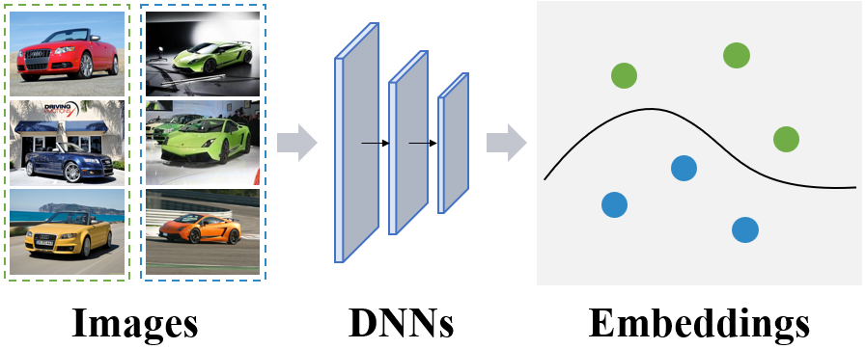
Introduction to Deep Metric Learning
Deep Metric Learning
An important technique to learn visual similarity
Foundation of various applications: face recognition, verification, image retrieval etc.
Goal
Learn a deep model that projects semantically similar data into nearby embedding space
Notes:
Deep Metric Learning is an important technique to learn visual similarity.
Its goal is to 直接读PPT

Slide 5
Existing Methods
Proxy-based methods
Training complexity scales linearly to the number of training classes
Softmax [Zhai and Wu. 2019]
ArcFace [Deng et al. 2019]
The applicability to real-life scenarios is limited.
Pair-based methods
Highly depend on effective embeddings to train
Contrastive [Hadsell et al. 2006]
Triplet [Schroff et al. 2015]
Margin [Wu et al. 2017]
How to acquire effective embeddings?
Notes:
There are two lines of work in DML.
The first kind is proxy-based methods. Their training complexity scales linearly to the number of training classes,
Limiting their applicability to real-life scenarios.
The second kind is pair-based methods. They are not affected by the number of training classes, but highly depend on 念PPT.
Therefore, to achieve successful DML. The question become how to acquire effective embeddings for pair-based methods?

Slide 6
Acquiring effective embeddings
Designing more effective sampling methods
Semi-hard [Schroff et al. 2015]
Distance-weighted [Wu, Chao-Yuan, et al. 2017]
Soft-hard [Roth et al. 2020]
Still limited by the number of embeddings.
Providing more embeddings for sampling
Constrained by the single GPU memory as the sampling process typically cannot cross different GPU devices [Roth et al. 2020]
Is there another way to provide more embeddings?
Notes:
Lots of works aim to provide effective embeddings to improve pair-based DML.
However, the upper bound of sampling methods is limited by the number of embeddings.
Therefore, the ultimate solution is to provide more embeddings for sampling.
However, the number of embeddings is constrained by 读PPT.
We ask the question, is there 读PPT

Slide 7
Pseudo Embedding Generation
Existing methods
Hard example generation [Duan et al. 2018], [Zheng et al. 2019]
Embedding expansion [Ko et al. 2017]
Cross batch memory [Wang et al. 2020]
Limitations
Heavy computation cost: Require additional generative adversarial network or auto-encoder
Not compatible with existing DML methods: Require further modification to the sampling and loss computation process
How to produce embeddings efficiently and effectively without modifying existing DML methods?
Notes:
The answer is pseudo embedding generation.
Existing methods include 念PPT
But they have the following major limitations: First 念PPT，Second 念PPT
Based on the background, the focus of our paper is 念PPT

Slide 8
Contents
1
Background
2
Motivation
3
Proposed Method
4
Experimental Results
5
Conclusion
Notes:
The motivation part is coming.

Slide 9
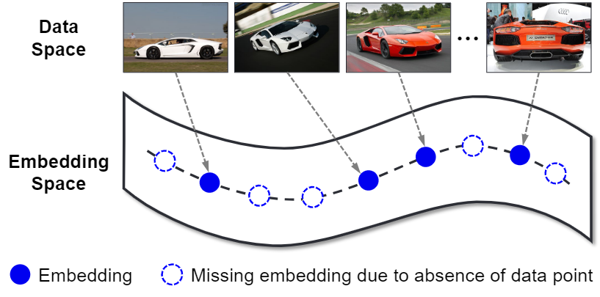
Take a Deep Look in the Embedding (Space)
The basic hypothesis of metric learning
Embeddings close to each other in the embedding space have similar semantics
The missing embedding issue
The embedding space often has a barren area due to the absence of data points
How can we leverage the semantic in the embedding space
to fill the barren area?
Notes:
The basic hypothesis of 念PPT
Therefore, the missing embedding issue is often the case since 念PPT
So, how can we 念PPT

Slide 10
Contents
1
Background
2
Motivation
3
Proposed Method
4
Experimental Results
5
Conclusion
Notes:
Here comes our method.

Slide 11
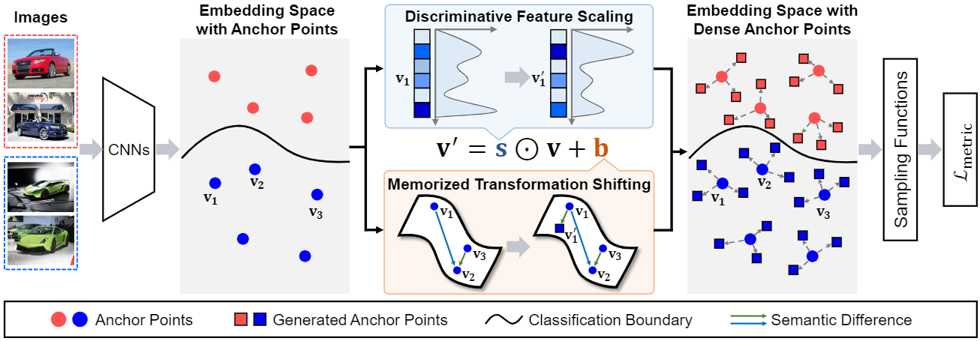

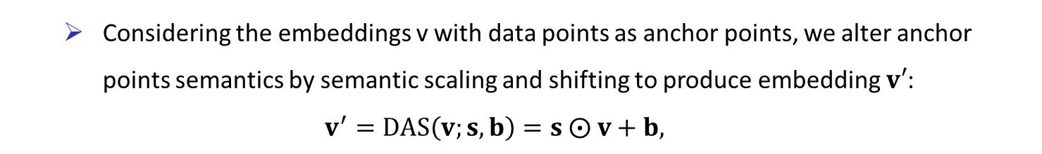
Proposed Method
Densely-Anchored Sampling for Deep Metric Learning
Considering the embeddings v with data points as anchor points, we alter anchor points semantics by semantic scaling and shifting to produce embedding $v′$:
$$v^{′}=DAS\left(v;s,b\right)=s ⨀ v+b,$$
where $s$ and $b$ denote the semantic scaling and shifting factors, respectively.
How to get the semantic scaling and shifting factors?
Notes:
The proposed densely-anchored sampling approach is a plug-and-play module.
The main idea is that considering the embedding with data points as anchor points.
Then, we perform semantic scaling and shifting to produce pseudo embeddings.
The question is how to get the semantic scaling and shifting factors?

Slide 12
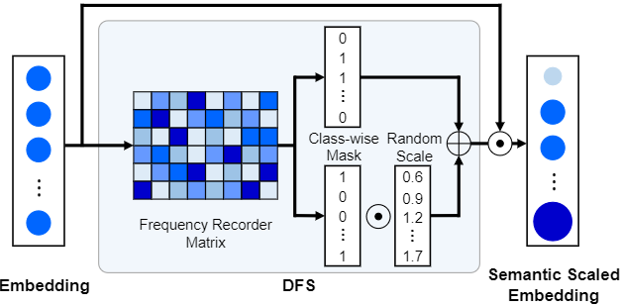
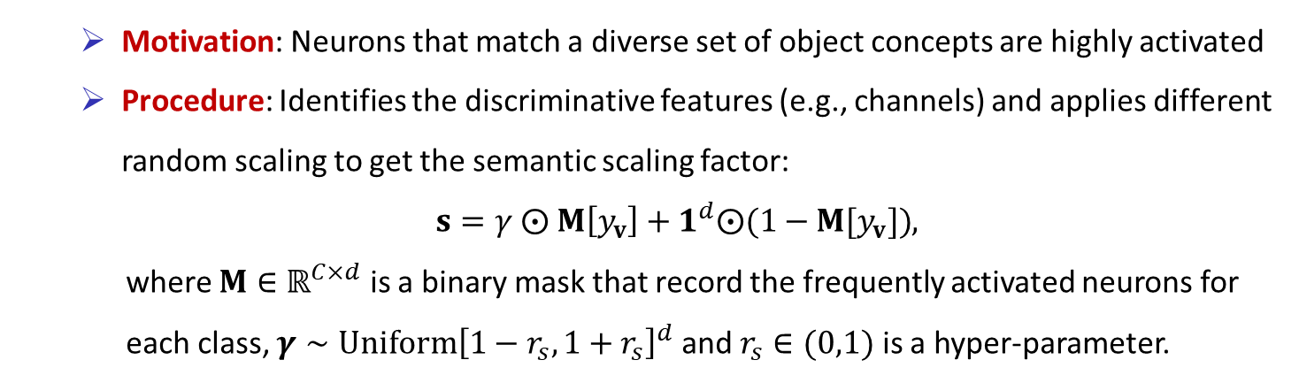
Proposed Method
Discriminative Feature Scaling (DFS)
Motivation: Neurons that match a diverse set of object concepts are highly activated
Procedure: Identifies the discriminative features (e.g., channels) and applies different random scaling to get the semantic scaling factor:
$s=γ ⨀ M\left[y_{v}\right]+1^{d}⨀(1−M[y_{v}])$,
where $M∈ℝ^{C×d}$ is a binary mask that record the frequently activated neurons for
each class, $γ∼Uniform{\left[1−r_{s},1+r_{s}\right]}^{d}$ and $r_{s}∈(0,1)$ is a hyper-parameter.
Notes:
We get the semantic scaling factors by discriminative feature scaling module.
The motivation is that 念PPT
Therefore, we identify 念PPT

Slide 13
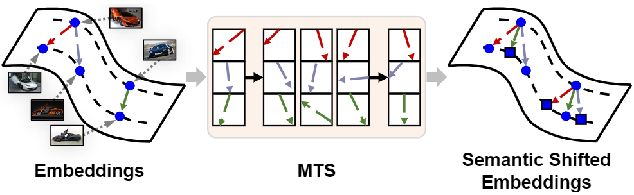
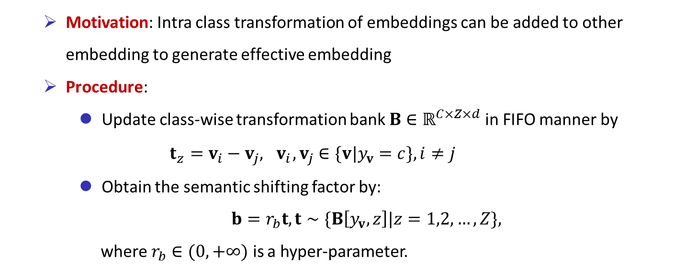
Proposed Method
Memorized Transformation Shifting (MTS)
Motivation: Intra class transformation of embeddings can be added to other embedding to generate effective embedding
Procedure:
Update class-wise transformation bank $B∈ℝ^{C×Z×d}$ in FIFO manner by
$$t_{z}=v_{i}−v_{j}, { v}_{i},v_{j}∈\{v|y_{v}=c\},i≠j$$
Obtain the semantic shifting factor by:
$b=r_{b}t, t∼\{B\left[y_{v},z\right]|z=1,2,…,Z\}$,
where $r_{b}∈(0,+∞)$ is a hyper-parameter.
Notes:
To get the semantic shifting factors, we leverage the memorized transformation shifting module
The motivation is that 念PPT
Since the number of embedding of each class is limited in standard DML pipeline, we matain a transformation bank.
We update the 念PPT
Then, we obtain the semantic shifting factor by sampling from the bank

Slide 14
Contents
1
Background
2
Motivation
3
Proposed Method
4
Experimental Results
5
Conclusion
Notes:
Now, we present our main experimental results

Slide 15
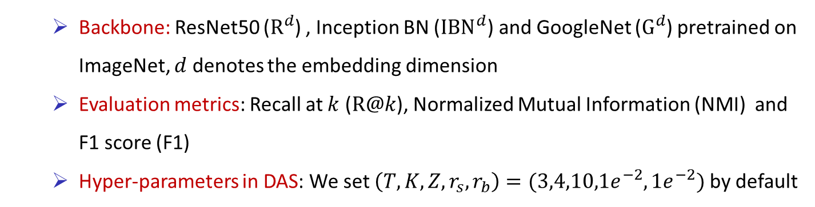
Experiment Setup
Dataset
CUB2011-200 (CUB): a fine-grained bird dataset, #Train / #Test classes: 100 / 100
CARS196 (CARS): a fine-grained vehicle dataset, #Train / #Test classes: 98 / 98
Stanford Online Products (SOP): a large-scale online products dataset, #Train / #Test classes: 11,318 / 11,316
Implementation details
Backbone: ResNet50 ($R^{d}$) , Inception BN (${IBN}^{d}$) and GoogleNet ($G^{d}$) pretrained on ImageNet, $d$ denotes the embedding dimension
Evaluation metrics: Recall at $k$ ($R@k$), Normalized Mutual Information (NMI) and F1 score (F1)
Hyper-parameters in DAS: We set $\left(T, K, Z, r_{s},r_{b}\right)=(3,4,10,1e^{−2},1e^{−2})$ by default
Notes:
We conduct experiments on three widely used datasets CUB, CARS and SOP.

Slide 16
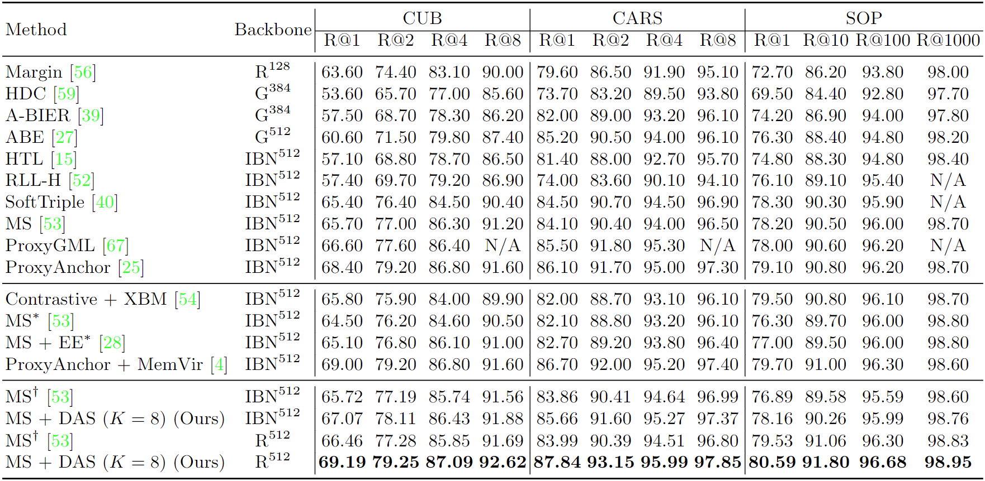
Main Results
Comparisons with SoTA Methods
DAS achieves superior performance under all datasets and evaluation metrics
Notes:
Compare with state-of-the-art method, we achieves 念PPT

Slide 17
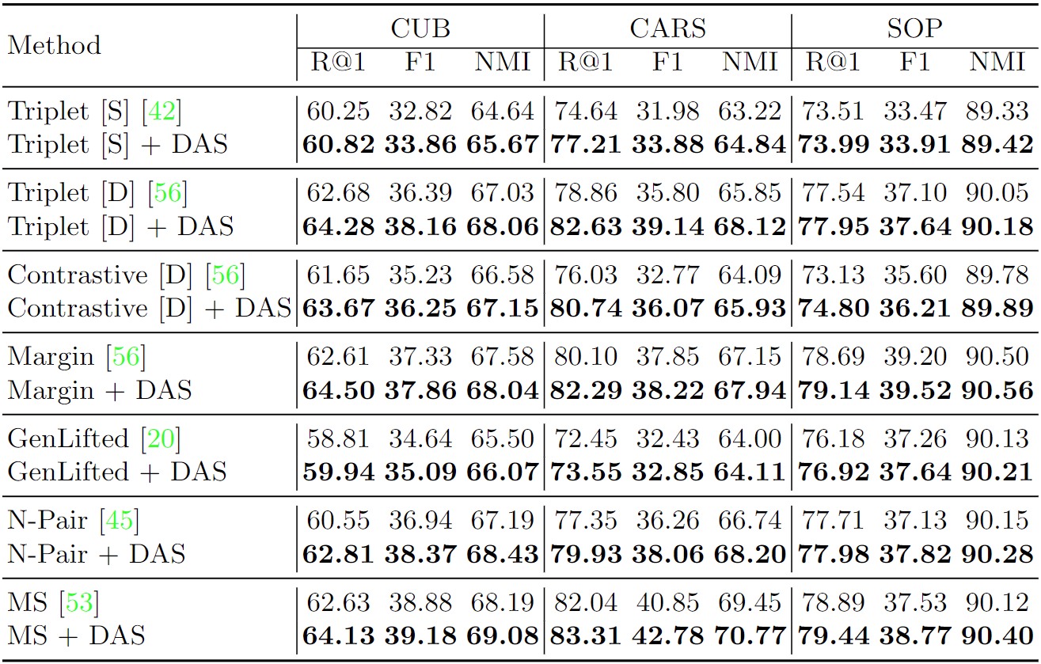
Main Results
Improvements over Pair-based Methods
DAS boosts the widely-used pair-based losses considerably under all metrics
Notes:
Our method also boots 念PPT

Slide 18
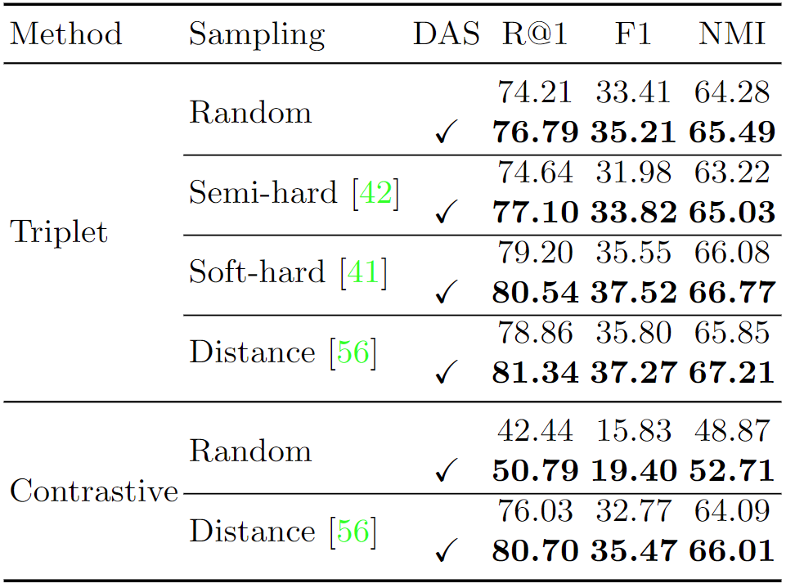
Main Results
Improvements over Sampling Methods on CARS
DAS is able to improve the widely-used sampling methods.
Notes:
Our method is also able to 念 PPT

Slide 19
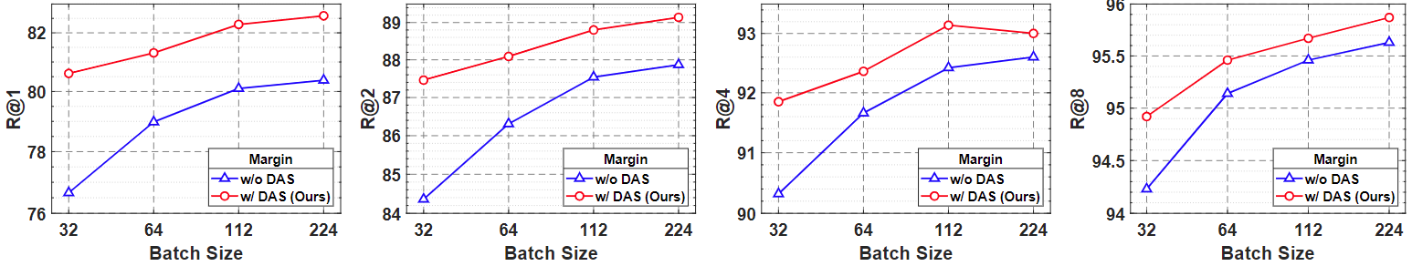
Main Results
Experiments with Different Batch Size
DAS consistently obtain better results under different batch size
DAS with batch size = 32 outperforms the baseline with batch size = 224
Notes:
Under different batch size, our method 念 PPT. Especially, with batch size 32, we outperform the baseline with batch size 224

Slide 20
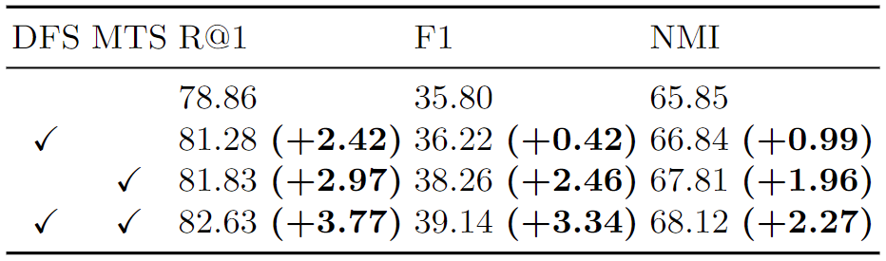
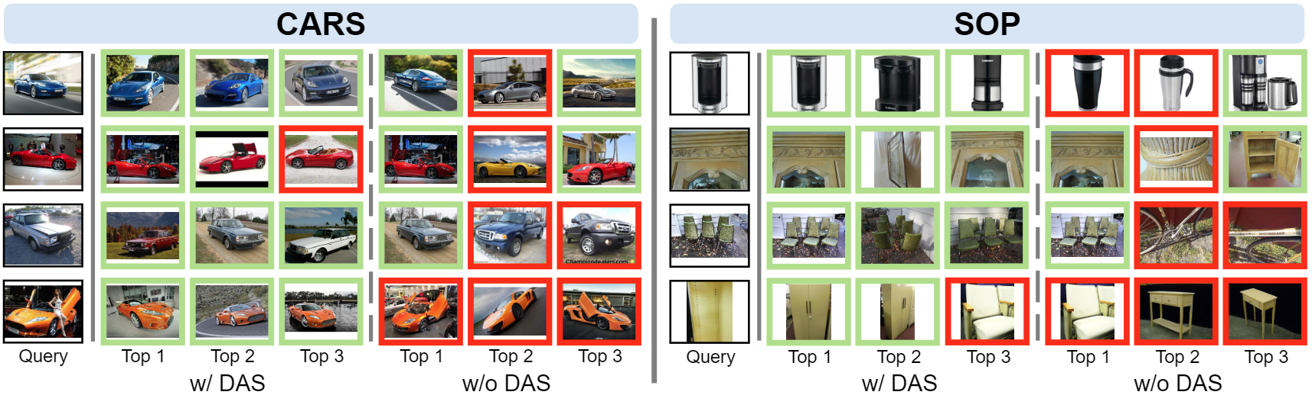
Ablation Studies and Qualitative Results
Ablation Studies on CARS
Image Retrieval Results
Notes:
The ablation study shows that all of our modules are effective.
The image retrieval results show that our method is able to distinguish semantic similar but appearance dissimilar samples.

Slide 21
Contents
1
Background
2
Motivation
3
Proposed Method
4
Experimental Results
5
Conclusion

Slide 22

Conclusion
Contributions
We propose a plug-and-play Densely-Anchored Sampling (DAS) scheme that exploits embeddings’ nearby embedding space and densely produces embeddings without data points to improve the sampling quality and performance of DML
To this end, we propose Discriminative Feature Scaling (DFS) and Memorized Transformation Shifting (MTS) to provide the semantic scaling and shifting factors
Extensive experiments demonstrate the effectiveness of the proposed method
For more details, please visit:
https://github.com/lizhaoliu-Lec/DAS
Contact: {selizhaoliu,sevtars}@mail.scut.edu.cn
Notes:
We summarize our contribution as follow. For more information, please visit our project website. Thanks for watching.

